Slide 1
Braille, Disease and Doctors. <Introduction>
- Why braille, disease and doctors?
Aside from general curiosity and a wish to see possible correlation, this presentation attempts to raise awareness regarding people who went blind due to a disease, the number of doctors that exist in the world and what can blind people do when it comes to braille? I want to demonstrate that blind people, despite being blind can still have quality of life and ability or at least access to technology.
Blindness a common problem. According to WHO there are at least 2.2 billion blind people. It is important to note that there are many kinds of blindness however, since one of my datasets on trachoma I will be considering blindness to be “total blindness”.

Slide 2
<Data description>
For my project I choose 3 datasets:
Braille Literacy & Accessibility for Blind Persons - Kaggle
Trachoma : cause - Kaggle
Physicians (per 1,000 people) – World Bank Group
Reason why I choose the following datasets:
Braille and trachoma – have blindness in common
Trachoma and physicians – have medical relationship, which is: disease and doctor
Those datasets were found online, and all the datasets were in a table view with 17,3,4 columns, respectively.
continents.json – GitHub gist, was used for map visualisation in python

Slide 3
<Data description>
The plan is to create infographic that will:
Demonstrate the map of continents where gold is big, and purple is small.
Tree maps will show the size in order to compliment maps and other data.
Stacked-bars will be used to display continents or countries in relation to a specific data.
A pie chart to show the percentage of people in comparison to some data.
Display maps with continents with various colours depending on the data.
In terms of technologies the plan is to use Tableau, Python and tableau public. Why?
Tableau will be used to create the tree maps, stacked bars, and pie charts
Python will be used to create maps
Tableau public will be used to bring everything together and display both python and tableau

Slide 4
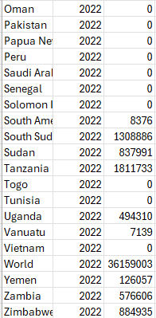
<Visualization Plan>
My plan is simple - I want to generalize the data from: France and UK to Europe.
I will be trying to change my datasets according to this link. Focusing on (Africa, Asia, Europe, America, Oceania and Middle East). I am also considering using dashboard with the (purple-yellow colour schemes) due to this video in an attempt of making my visualisations colour-blind friendly.
First of all – I will be converting all the dataset’s country/region columns into a uniform continent column to unify them and prevent missing data.
Second of all – I will be removing most of the data which is time-series oriented, simply due to fact that I need data to be more than 0 unlike the image there -->
(Despite Middle East being a region and not a continent the choice was
to keep it and prevent major data loss, same goes to Oceania region)
You might have noticed that I used physicians instead of ophthalmologist which – considering we
are dealing with vision would be more appropriate choice – unfortunately, I couldn’t find suitable
dataset for that.

Slide 5

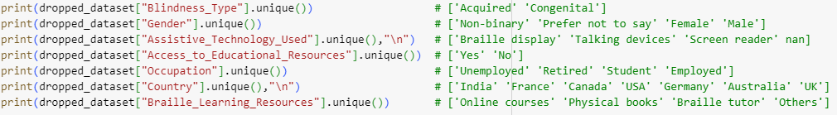
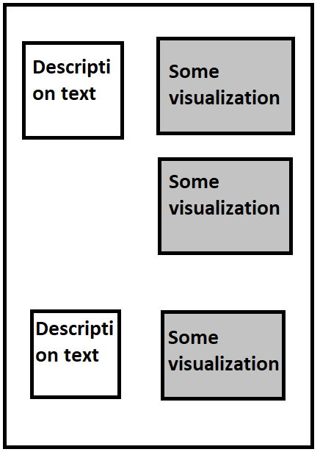
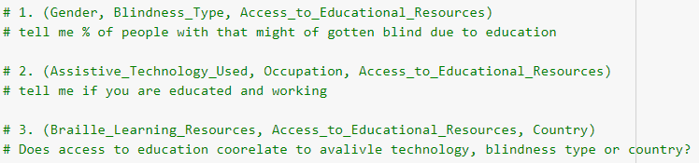
<Visualization Plan>
Additionally, you might have noticed that all of my datasets contain regions, countries or continents in some form or another. This is because I don’t just focus on blindness in a specific place but rather try and cover as much of the world as much as possible.
For Braille dataset following needs to be removed:
Why?
Because Person_ID, Braille and English letters can’t be used anywhere.
The rest are useful as they can convey important information and are useful in general. However, they are not useful to me as the purpose of this dataset was to get country’s blindnesses and keep the following fields below for visualisations:
Here is a quick example
of how infographic would
Look like:

Slide 6
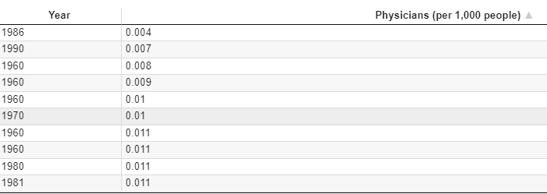
<Visualization Plan>
For Trachoma and Physicians, it’s a little different. Since trachoma has 3 columns, the plan is to get the highest number of cases recorded.
Why?
Because in some latest cases the data 0 which, for statistics is good but for this project isn’t ideal as the hope is to get the largest value per country and use the maximum numbers across all the continents to get the mean.
Similar for physicians. However, this time the data will be latest, this is because the dataset doesn’t contain any 0 values. After getting the latest numbers for each, the plan is to get max and mean
number of physicians per continent, and as a proof of not having 0’s here is the snip of a dataset.
The reason why braille, trachoma and physicians were picked is because they have common topics of:
Braille and Trachoma – Blindness
Trachoma and Physicians – Medical

Slide 7
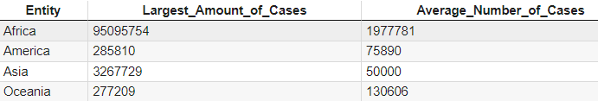
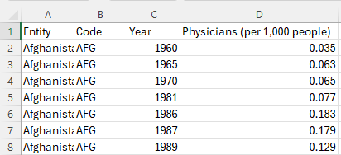
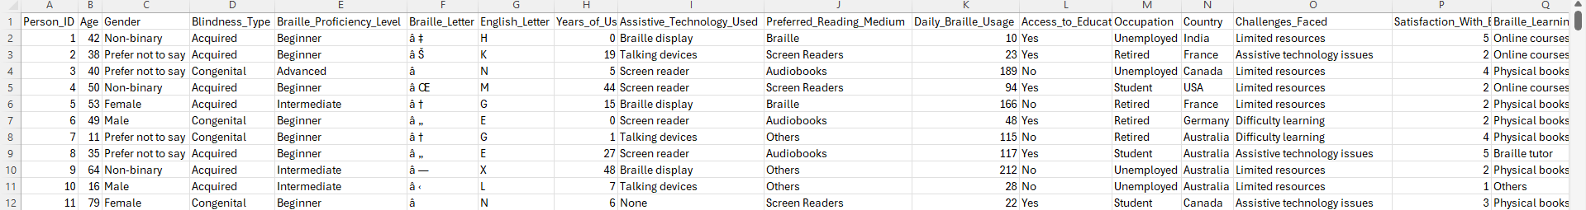
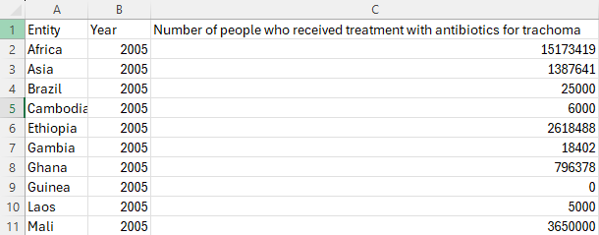
<Visualization Plan>
What about the bias and making the data misleading?
This is why the latest numbers are used for physicians, the fresher the data, the better.
On the other hand, grouping countries by continent will make the data more general which, could make certain places look differently than they are, thus introducing bias. For example:
Here the Asia has 65.4 difference!
Despite introducing bias, having a lot of data does help in understanding, if the average number of trachoma cases is small and the largest number is big, one might conclude that trachoma isn’t as big of a problem unlike Oceania where the difference is only 2.1 between the numbers.
Here are quick snips of data before any modifications were made:

Slide 8

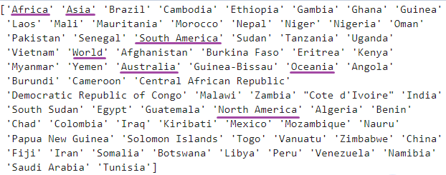
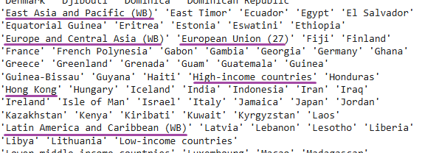
<Data Loading & Cleaning>
After the initial load with >>>
We check for missing and unusable data with: dataset.unique() command
notice that we have continents, world
and countries all in one place (not good)
Let’s look at another dataset (below).
222 items! That’s a lot. Unfortunately,
those items need cleaning, and
here is why: not only are there countries,
but also, there are income-based countries
and combinations like (European Union 27)

Slide 9
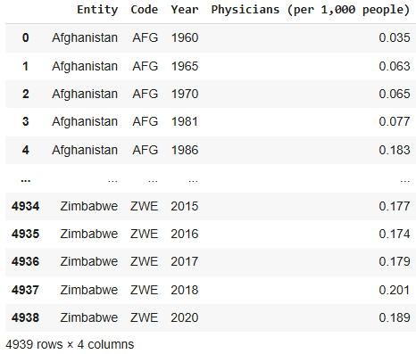
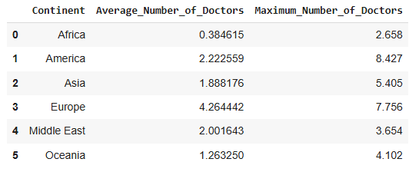
<Data Loading & Cleaning>
1. First, I will get rid of some of the data in datasets.
2. Then, I will group them by continent.
3. After that, let’s find the latest years per each country and get mean and max for continents in which those countries appear in.
4. Create a new data frame with continent, average and
max number of physicians per continent and finally export it.
Effectively changing the dataset from (Start) to (End):
Start>>> <<<End

Slide 10
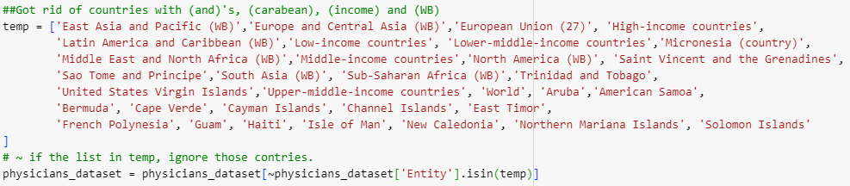
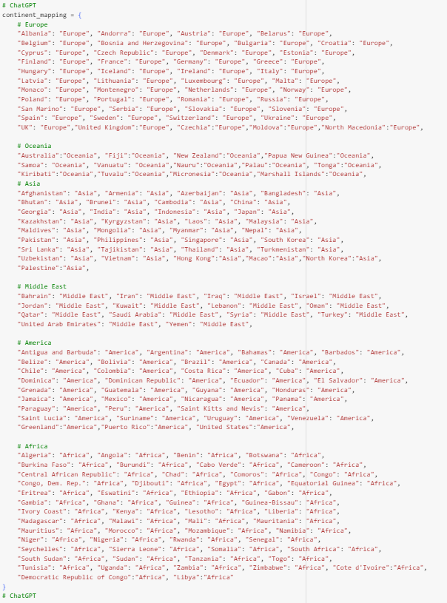
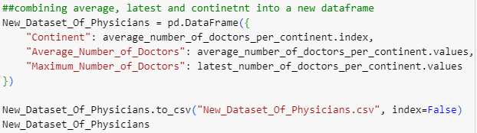

<Data Loading & Cleaning>
Steps for previous slide in code: (outlines shows separate steps)
<< Step 1: delete data
Step 3: latest year, mean and max of that
< Step 2: make new
field (continent)
Step 4: new data frame, with continent, av and max

Slide 11
<Data Loading & Cleaning>
Now, let’s get trachoma and braille sorted, starting with trachoma.
Get rid of countries with no cases
Group countries into continents
Get the mean and max values per each continent
Merge the mean and max columns into new table by entity.
Count and store the numbers in new data frame , In new data frame, group previous dataset by country and blindness type. Pivot table, making each country have unique blindness type
Replace country with continent and sum all duplicates into 1 continent

Slide 12
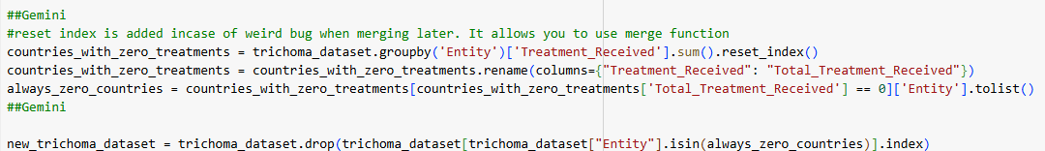
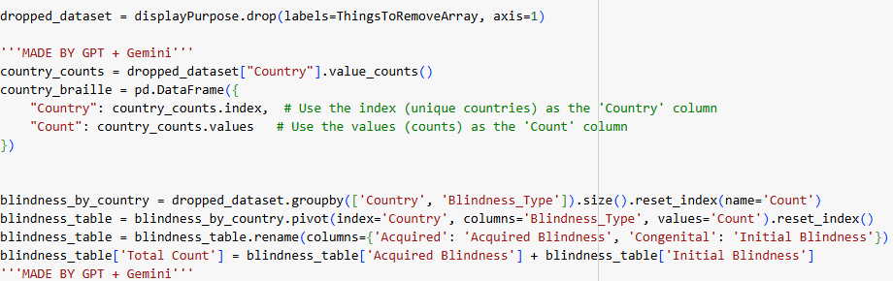
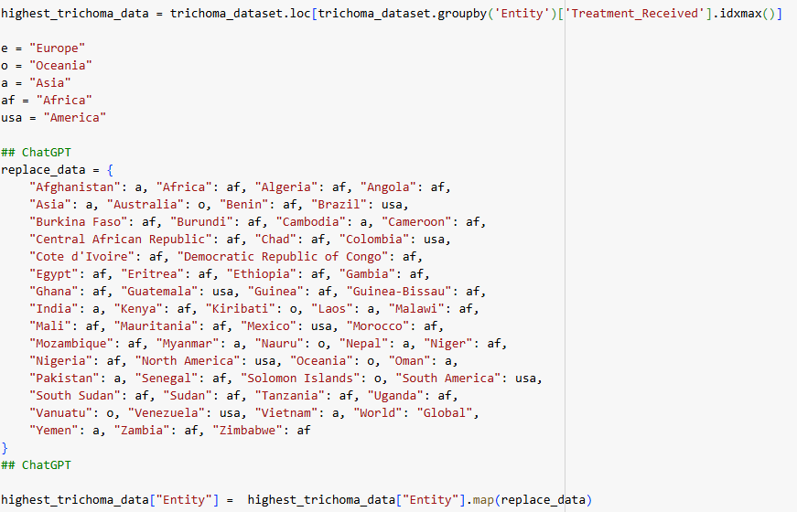
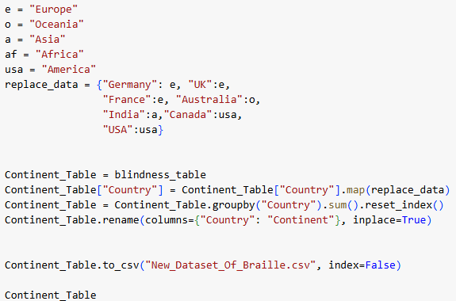
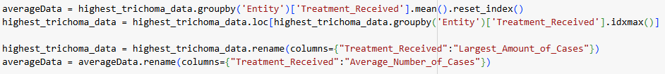
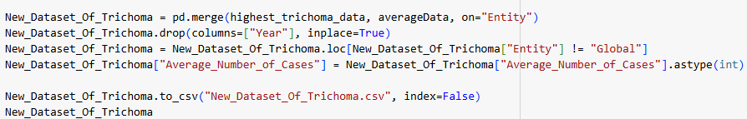
<Data Loading & Cleaning>
Trachoma dataset is on the left, braille dataset is on the right
Step 1 – No records removal
Step 1 – count countries, merge by blindness
Step 2 – Group by country
Step 3 – mean and max
Per
continent
Step 2 – Replace country with continent, removing copies
Step 4 – Merge step 3 into new table

Slide 13
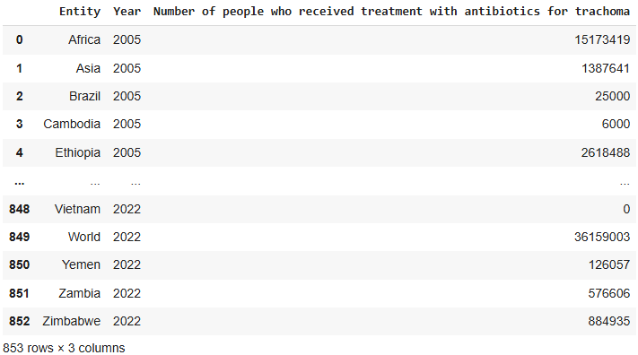
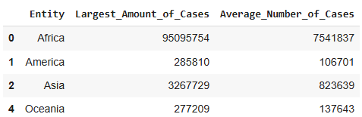
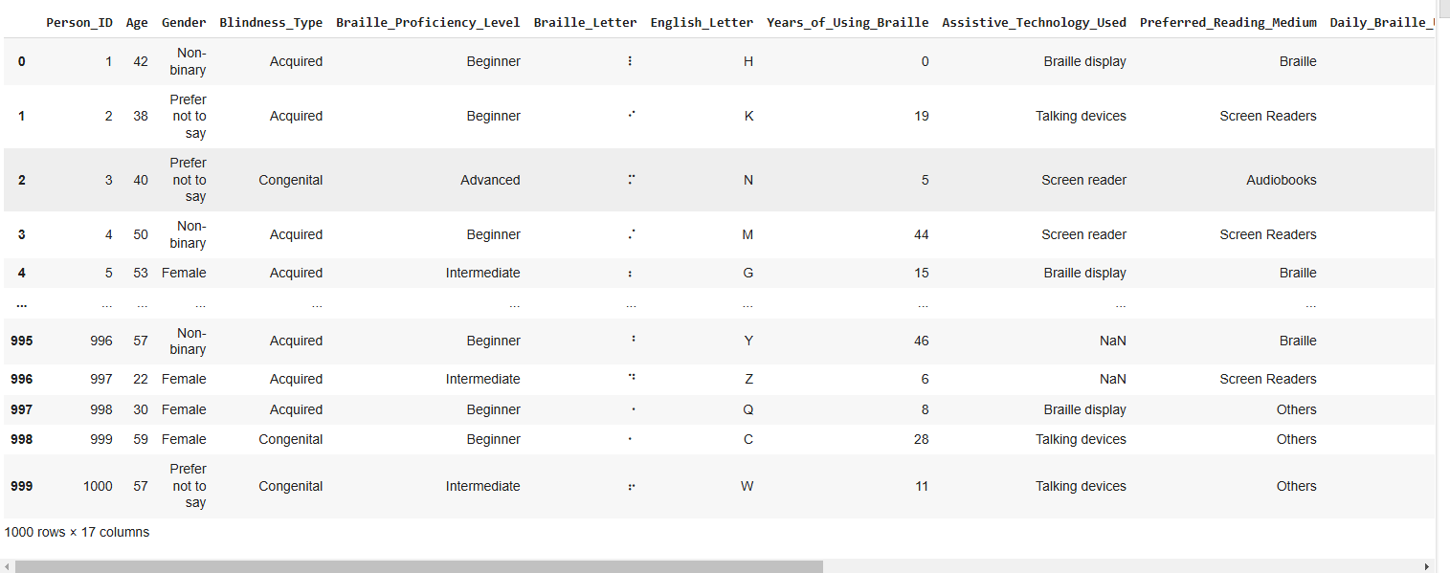
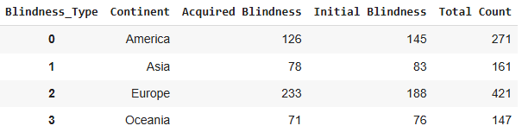
<Data Loading & Cleaning>
Here is how the datasets would look like before and after the cleaning. Trachoma on the top, braille on the bottom. Before >>> After

Slide 14
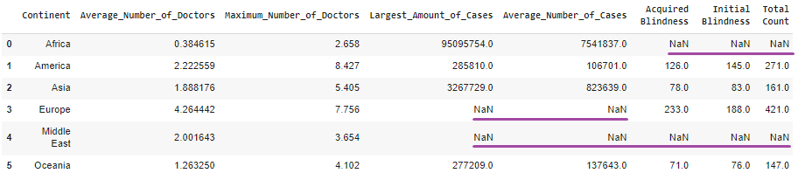
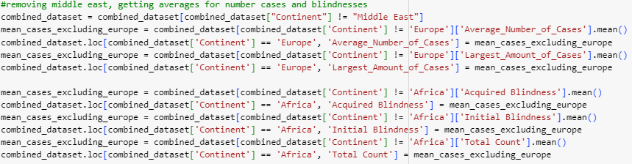
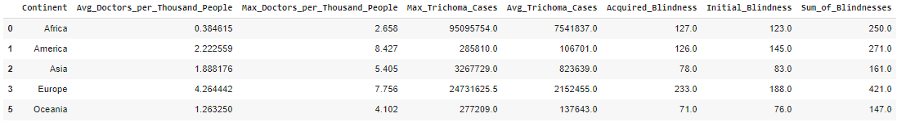
<Data Loading & Cleaning>
Lastly, all 3 datasets are going to be merged. However, if we do that, we will get missing data:
Additionally, we also lost fields for braille which, due to the diversity of data isn’t possible as if I sum all unique values, I will end up with over 1,024 combinations in the worst case. So instead, I will get rid of middle east and give mean to fields with no data. Lastly all the code can be seen on GitHub, Colab or Tableau public.

